Slide 1


Accreditation Midterm Report
March 2013

Slide 2
Content Layout
Statement on Report Preparation
Response to Recommendations
Recommendations One to Four
Response to Self-Identified Planning Agendas
  Standards IIA, IIC, IIID, and IVB
Response to ACCJC letter about USDE and Title IV Funds
Substantive Change in Progress, Pending, or Planned

Slide 3

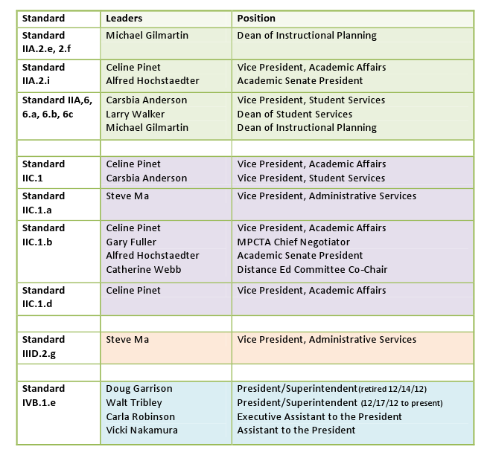
Statement on Report
Preparation

Slide 4
RecommendationS
(1) That the college complete the process of assessment to guide improvement of student learning.
(2) That the college completes the process of identifying course level SLOs and ensures student information is clear, that SLOs are described, and that students receive syllabi reflective of the SLOs.
(3) That the college take steps to ensure that faculty and others directly responsible for student progress toward achieving stated SLOs have, as a component of their evaluation, effectiveness in producing those outcomes.
(4) That the college follow through with a plan to design an evaluation process and evaluation tool to provide students an opportunity to evaluate online courses. Plus that the DE Task Force develop clear protocols and strategic goals for distance education learners.

Slide 5
RecommendationS: Example of Structure
Link to Response to Recommendation
  http://www.mpc.edu/information/accreditation/Accreditation%20Documents/ACCJC%20Follow-up%20Report%20Response%20to%20Recs%201%20to%203%20October%202012.pdf
Summary of Response to Recommendation
Progress since submittal of Response to Recommendation
  Improving the form used to guide program reflections dialog
  Ongoing dialog about SLOs now naturally occurring outside formal “reflections” process:
  Tying Component Goals to the Education Master Plan, for integrated planning and institutional effectiveness in support of student learning.
Evidence of Progress in Response to Recommendation
  http://www.mpcfaculty.net/senate/ProgramReview/ProgramReflectionsSpring13.pdf
  MPC Educational Master Plan:

Slide 6
Self-Identified Planning Agendas
Train faculty to use the CurricUNET system.
Complete the General Education SLOs.
Evaluate incoming transfer coursework and ensure it is comparable to MPC courses.
Inform faculty & staff of services available, location and hours of operation.
Examine on-campus computer use and develop plan to replace equipment and upgrade software on congruent with resources.
Design an evaluation process for all online courses.
Examine access to Library and Tech Center and implement plan to secure building.
Implement system to process purchase requisitions online and computerize the district’s capital asset accounting.
Inform the college community of board policy revisions.

Slide 7
Self-Identified Planning Agendas : Example of Structure
Standard IIA.2e, 2.f Definition
Plan recommendation: The CurricUNET specialist, under the supervision of the Dean of Instructional Planning, will train faculty to use the CurricUNETsystem.
Status and Progress Made: Implemented and Ongoing
Evidence

Slide 8
OTHER ITEMS
Response to ACCJC letter about USDE and Title IV Funds
Update on Substantive Change in Progress, Pending, or Planned
SB 1440 Transfer Degrees

Slide 9
QUESTION?

