Slide 1
EOC Debriefing
Power Outage
October 5th, 2011
10:10AM
Emergency Preparedness Training of 10/20/11 , in observance of the California Shakeout.

Slide 2
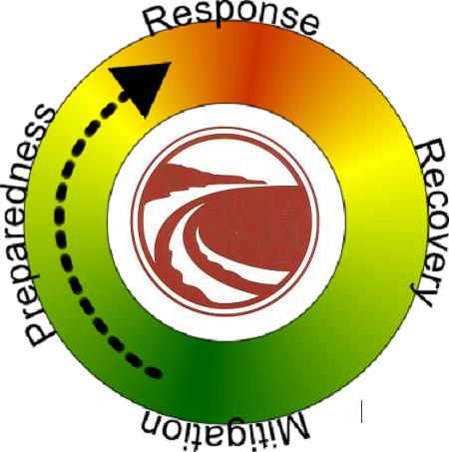
EOC Phases

Slide 3
Response
Power outage @ 10:10 AM.
Security monitors MPD responding to power lines down on Jocelyn Canyon Rd.
MPD reports multiple traffic signal lights are out.
Security reports to Administration and verifies power outage is citywide.
EOC is activated @ 10:15 AM, facilities contacts PG&E.
10 :30 AM PG&E reports 3800 customers are effected, power restoration estimated 1:00 PM.

Slide 4
Response
10:40 AM Directive from EOC: “Faculty and Staff to remain on campus until directed otherwise. Instructors to continue with classes if safe and functional to do so, otherwise, at their discretion, they may excuse class”.
10:45 Am EOC attempts to contact via cell phone using the BRT contact list.
Facilities and Security personnel conduct building to building contact, verify all elevators clear.
11:15 east and west side of campus complete.
11:17 AM Power restored.

Slide 5
What Went Right?
Emergency generator at Administration started supplying power to servers and telephones at 10:10 AM
Emergency lighting activated
Security verifies citywide power outage
EOC is activated
Directive is issued by the EOC Manager (President)
Teams conduct building to building contact
Two BRT members contact EOC

Slide 6
What Went Wrong?
Few land lines worked. UPS availability. What are the expectations?
Not all EOC personnel on campus responded or contacted the EOC. Correct protocol all EOC members on campus must report to the EOC or contact the EOC. Who is on the EOC List?
Building Response teams did not use the new EOC cell numbers for contact. BRT are expected to contact EOC using the call in numbers.

Slide 7
What Went Wrong?
Building to Building Teams (Runners) did not communicate with the EOC. Contact Teams must report in with the EOC and give a status report.
A Status List was not developed and posted at the EOC.

Slide 8
California Shake Out

Slide 10
Homeland Security Risk Assessment Update
Extreme Weather was added to the risk assessment preparedness list in 2010.
Floods
Tornados
Hurricanes
Earthquakes
ARkStorms

Slide 11
ARkStorm
The U.S. Geological Survey, Multi Hazards Demonstration Project (MHDP) uses hazards science to improve resiliency of communities to natural disasters including earthquakes, tsunamis, wildfires, landslides, floods and coastal erosion.
California Shake Out
ARkStorm

Slide 12
Mitigation
Emergency Generator
Emergency Lights
Flashlights
Cell Phones
PG&E contact phone numbers

Slide 13
Preparedness
Emergency Plan
Table Top Drills
Building Response Team Training
EOC Training

