Slide 1
Enrollment Management
Report to
Monterey Peninsula College
CBT
May 10, 2016

Slide 2
What is Enrollment Management?
Development of class
schedule that
meets student need:
Transfer/degree/certificate
Work-related skills
Enhance competencies
Appropriate planning to maximize the amount of funded Full-time Equivalent Students (FTES) the college can generate

Slide 3
Discussion of Present Practices
Student Information system (SIS) – old, archaic, hurts students, unreliable, increases work by hand
Lack of systematized processes – widespread
FTES generation – woefully low, not adequate to fund the on-going costs of the college
  17.5 FTES/FTEF represents the point where a college generates enough money to cover on-going costs.
Productivity | Fall 14 | Spring 15 | Fall 15 | Spring 16
FTES/FTEF(excluding RT)* | 13.96 | 13.286 | 14.237 | 13.455
FTES/FTEF(including RT)* | 12.725 | 12.146 | 12.976 | 12.270
* RT = Reassigned Time; excludes contracts

Slide 4
Lack of FTEF/FTES master planning to achieve FTES target
Lack of understanding of how many, on average, students it takes to achieve 17.5 FTES/FTEF (35 students)
  Spring 2016
    the mean class was 23
    the median class size was 19
Class offerings lack balance
  Transfer/degree programs need to be the core
  Lack planned, comprehensive packages for
    Evening at Monterey campus
    Day and evening at Marina campus

Slide 5
Approach Used to Assist MPC with Enrollment Management
Conduct training
Conduct analyses
Form work group to study and recommend more effective operational enrollment management processes
  Here is what emerged from the workgroup:
    Recommendations
    “Parking lot issues”
    Sub groups

Slide 6
Work group
Purpose of Project
Ensure that enrollment management processes
at MPC are ones that are:
Data-driven
Follow agreed to procedures
Transparent to all college constituents
Focused on student need

Slide 7
Work Group Membership
CBT Enrollment Mgmt. specialist: | Pam Deegan
VP Academic Affairs: | Kiran Kamath
Instructional Deans: | Laura Franklin, Michael Gilmartin, Jon Knolle
Scheduling Tech: | Joe Nguyen
Division Chairs: | Leandro Castillo, Diane Boynton
Department Chairs: | Tracie Catania, Lauren Handley, Gamble Madsen
Division Office Managers: | Rosa Arroyo, Michele Brock
Counselor: | LaRon Johnson
Academic Affairs Support : | Leslie Procive
Student Services/A&R: | Nicole Dunne

Slide 8
Recommendations

Slide 9
Time Blocks
FROM
Monday/Wednesday/Friday
Tuesday/Thursday
TO
Monday/Wednesday
Tuesday/Thursday
Friday

Slide 10
MPC Time Blocks
2 Days Per Week – Full Term
3 Hour Lecture – 51 Hours
2 Days Per Week – Full Term
4 Hour Lecture – 68 Hours
2 Days Per Week – Full Term
5 Hour Lecture – 85 Hours
MW | 8:00 am – 9:20 am
MW | 9:30 am– 10:50 am
MW | 11:00 am– 12:20 pm
MW | 12:30 pm – 1:50 pm
MW | 2:00 pm – 3:20 pm
MW | 3:30 pm – 4:50 pm
MW | 5:00 pm – 6:20 pm
TTH | 8:00 am – 9:20 am
TTH | 9:30 am– 10:50 am
TTH | 11:00 am –12:20 pm
TTH | 12:30 pm – 1:50 pm
TTH | 2:00 pm – 3:20 pm
TTH | 3:30 pm – 4:50 pm
TTH | 5:00 pm – 6:20 pm
MW | 7:30 am – 9:20 am
MW | *9:00 am – 10:50 am
MW | 11:00 am– 12:50 pm
MW | 1:00 pm – 2:50 pm
MW | 3:00 pm – 4:50 pm
MW | 5:00 pm – 6:50 pm
TTH | 7:30 am – 9:20 am
TTH | *9:00 am – 10:50 am
TTH | 11:00 am– 12:50 pm
TTH | 1:00 pm – 2:50 pm
TTH | 3:00 pm – 4:50 pm
TTH | 5:00 pm – 6:50 pm
MW | 8:00 am -10:20 am
MW | 10:30 am – 12:50 pm
MW | 1:00 pm – 3:20 pm
MW | 3:30 pm – 5:50 pm
MW | 6:00 pm – 8:20 pm
TTH | 8:00 am -10:20 am
TTH | 10:30 am – 12:50 pm
TTH | 1:00 pm – 3:20 pm
TTH | 3:30 pm – 5:50 pm
TTH | 6:00 pm – 8:20 pm
1 Day Per Week – Full Term
M, T, W or TH | 3:30 pm – 6:20pm
M, T, W or TH | 6:30 pm – 9:20 pm Or 7:00 pm – 9:50 pm
Friday | Needs to end before noon
Friday | Starts after noon
College Hour alternate Fridays
12:00 – 2:00 pm
(does not stop classes
from being offered)
* time overlap is intentional to provide maximum student options

Slide 11
Advantages of MW, TTH, F Blocks
Good for students
Increases FTES
Maximizes room use

Slide 12
Schedule Development
Work group requested to President Tribley:
  Schedule semester by semester
  Recommendation was accepted with the understanding that each program will publicize a two-year plan that drives schedule development
  Will revisit concept of annual schedule building concept as processes improve and EMS is implemented

Slide 13
Production Timelines
Schedule in Fall for Fall and Summer
Schedule in Spring for Spring
  Allows analyses of past semesters to make good student-focused decisions
Class schedule development calendar should be predictable, transparent, and planned
  Calendar outlines who does what and when
  Assures faculty input

Slide 14
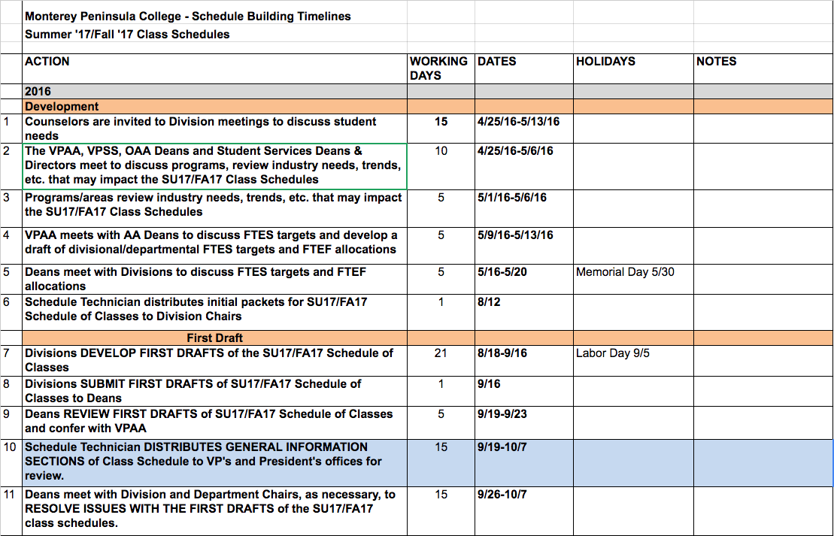
Planning Calendar

Slide 15
Two-Year Schedule Plans
Goal is to have two-year plans guide the schedule development process.
  Post two-year plans online to program webpage for students interested in the programs
  Have transfer packages available too!

Slide 16
Analysis for Two-Year Planning
Course | Title | MPC GE Area(s) | IGETC Area(s) | CSU GE Area(s) | Transfer Major AA-T/AS-T | Degree or Certificate | Required Course in Degree | Elective Course In Degree | Online | Mean Class Size (2 year F/S)
Basic
Skills
https://docs.google.com/spreadsheets/d/1hPXVZ1bNey_ztuwN_p-xA7VV6zm_w3e_eElPRRUWYRc/edit?usp=sharing

Slide 17
Sample Two Year Schedule Plan
Course | Title | Fall 1 | Spring 1 | Summer 1 | Fall 2 | Spring 2 | Summer 2
SPCH 1 | Public Speaking | ✓ | ✓ | ✓ | ✓ | ✓ | ✓
SPCH 3 | Interpersonal Comm | ✓ | ✓ |  | ✓ | ✓
SPCH 5 | Oral Interp of Lit | ✓ |  |  | ✓
SPCH 10 | Comm Theory |  | ✓ |  |  | ✓

Slide 18
Schedule of Classes Information
ACC111 Accounting Principles I 3.0 Credits
Fundamental theory of accounting principles and procedures. Prerequisites: None.
Section Location Delivery Dates Days Times Instructor Availability
Books: 1 book
F | ES | S | X
✓ |  | ✓
30245 | Dobson Campus | In person -lecture | 1/14/14- 5/9/14 | TR | 9 AM – 10:15 AM | Lewis | Open 10 of 36 Seats available
sample

Slide 19
Curriculum Advisory Committee
(CAC)
Examine course maximums
Place agreed to course maximums in curriculum
Why?

Slide 20
Prepare FTEF Allotments with
FTES Targets for Divisions and Departments

Slide 21
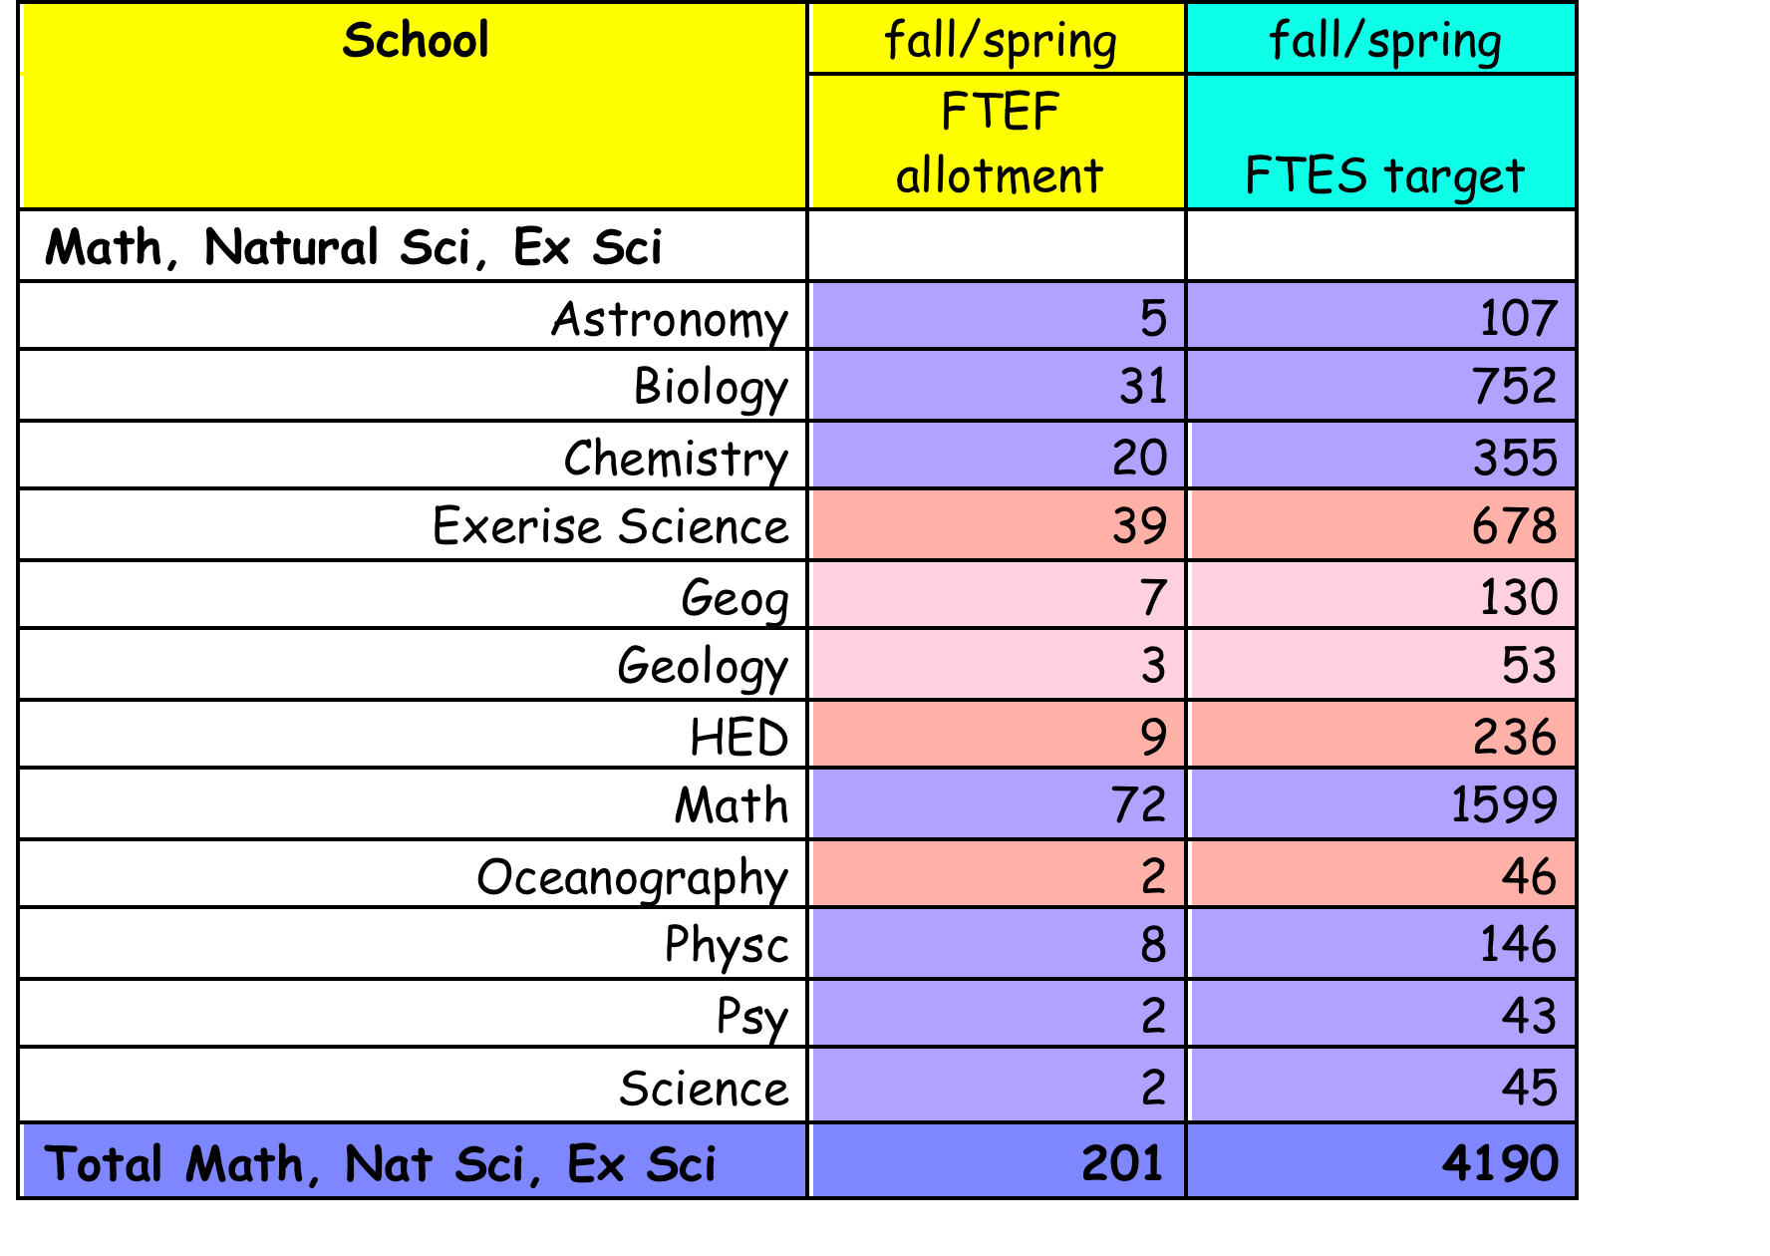
Sample of FTEF Allotments and FTES Targets
Example for another college; not
MPC
Numbers

Slide 22
Class Cancellations
Within the language of the contract:
  Discussion between deans and division chairs should occur before any class canceled
  Practice should be to cancel a class BEFORE the class starts
  Email/call every student and share available list of open classes that meet student need

Slide 23
Parking Lot Issues

Slide 24
“Parking Lot” Issues
Ed Plan Materials clean up
Invite division counselor to April/May division meeting to discuss schedule
Course enrollment maximums
Room inventory with class sizes using Google sheets
Clean up room inventory for all areas
Room allocation process and rules

Slide 25
“Parking Lot” Issues (cont’d)
Connections between Academic Affairs & Student Services on schedule to identify and address student needs
Curriculum process and timeline
Catalog process and timeline
Inventory of approved course outlines including date of approval
Energize part-time faculty pools

Slide 26
“Parking Lot” Issues (cont’d)
How to handle cross-listed sections
Google sheets/tracking scheduling changes
Catalog vs. schedule class descriptions
SIS constraints and the role of Enrollment Management System (EMS)
Clarify data included in reports, i.e. which students are counted and when, why, etc.

Slide 27
“Parking Lot” Issues (cont’d)
Provide student services and support during hours the college operates (i.e. evening). Establish and clarify campus hours.
Establish timeline/process to evaluate new schedule

Slide 28
Sub-Groups

Slide 29
Ed Plan Material clean-up | Alethea DeSoto, LaRon Johnson, Nicole Dunne, Kiran Kamath, Michael Gilmartin, Lauren Handley, Diane Boynton
Scheduling packets: | Jon Knolle, Tracie Catania, Laura Franklin, Joe Nguyen, Rosa Arroyo, Michele Brock, Michael Gilmartin
# of graduates/year by program: | Nicole Dunne
Classroom inventory clean-up: | Division Office Managers and IT person of the area
SIS Reports & accessibility: | Kiran Kamath, Michael Gilmartin, Jon Knolle, Laura Franklin
Classroom (status) Group: | Gamble Madsen, Kiran Kamath, Rosa Arroyo, Michele Brock
Summer Schedule Offerings: | Kiran Kamath, Michael Gilmartin, Jon Knolle, Laura Franklin, Counseling, Division Chairs
Marina and Evening GE Degrees: | LaRon Johnson, Leandro Castillo, Lauren Handley, Laura Franklin, Jon Knolle

Slide 30
Additional Recommendations from CBT
The college must replace its current SIS system to an Enterprise Resource Planning (ERP) system as soon as possible. SIS is archaic, inaccurate, and makes the processes at the college slow and tedious. Students are not served well by the system, nor are faculty or staff.
The college needs to continue to create processes that are well thought out, developed in concert with constituents, and are codified and followed at the college.
Every process at the college needs to be systematized and transparent to all. When an administrator leaves the college, it should not impact the college when systems are in place. Only when processes are person-dependent does chaos occur. That can be avoided by making sure that all processes are codified, written, and shared with all stakeholders.
.

Slide 31
Class maximums need to be identified and codified in the Course of Record (COR).
The bottom line for any academic decision needs to answer the question, “What is in the best interest of the student?”
Serious attention needs to be paid to the low class enrollments and the proliferation of these classes. This is crucial and ignored at the present time.
The college must institute FTEF allocations and FTES targets to assure that college FTES targets are met. As the method of funding the college and meeting student need, this has to become the primary goal of the all in instruction—administrator, chair, and faculty.
The transfer programs need to become a higher priority for the college.
The college needs to become less dependent upon Instructional Service Agreements. This can occur with systematic analyses and planning.

Slide 32
The organization requires fewer structural layers to assure that appropriate dialog occurs between those in the classroom and administration.
Processes need uniform enforcement. When many processes are developed, they are ignored and nothing happens to offenders. By default, “doing whatever you want” has become college practice.
This work group was very good and needs to continue its work and persist in its efforts to change practices that are in need of change.
The Parking Lot issues need resolution, as do the items listed in the subgroup work.
Links between Academic Affairs and Students Service need to increase.

